Slide 1
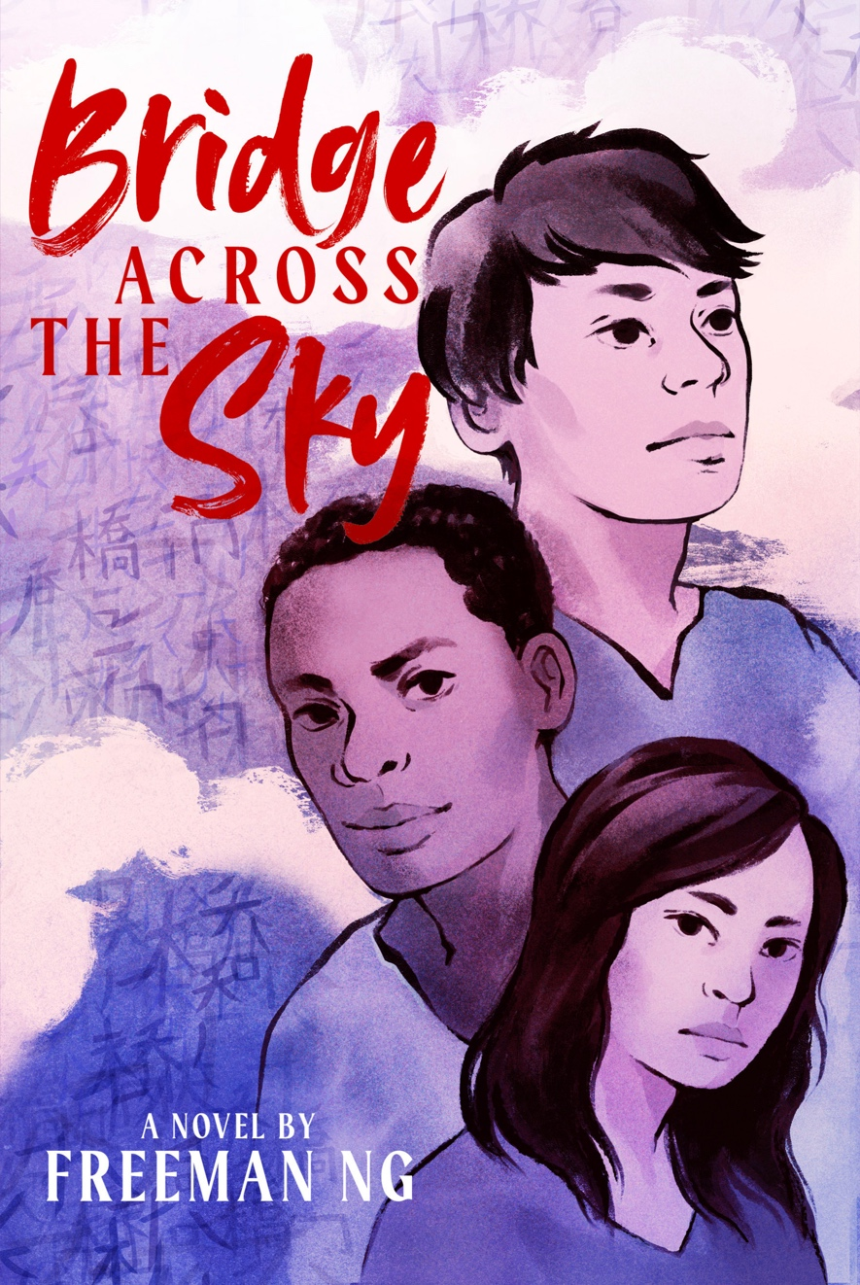
Bridge Across The Sky
The origins
The poems
The surprises
The revisions
This is an example of the presentation I might make to student writers. (vs. a general student audience, for which I have a different talk.) Each slide includes a note that explains what I’d say about it.
You can learn more about my novel at www.AngelIslandNovel.com

Slide 2
The Origins
The history
My friend’s father
My father
The poems
Notes:
Quick recap of the history of the station, and then the story of how I came to write the book.

Slide 3
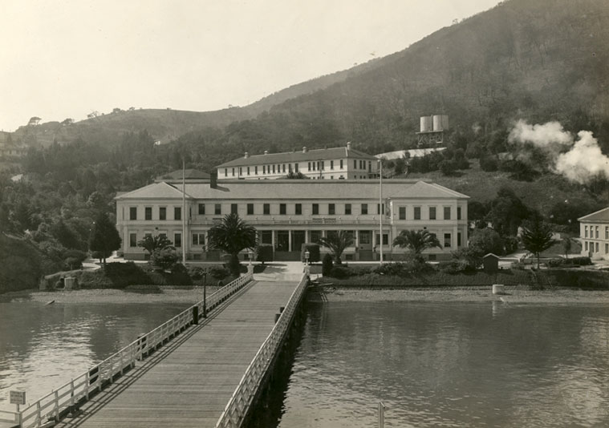
The History
Notes:
The Chinese Exclusion Act, “paper stories”, etc.

Slide 4
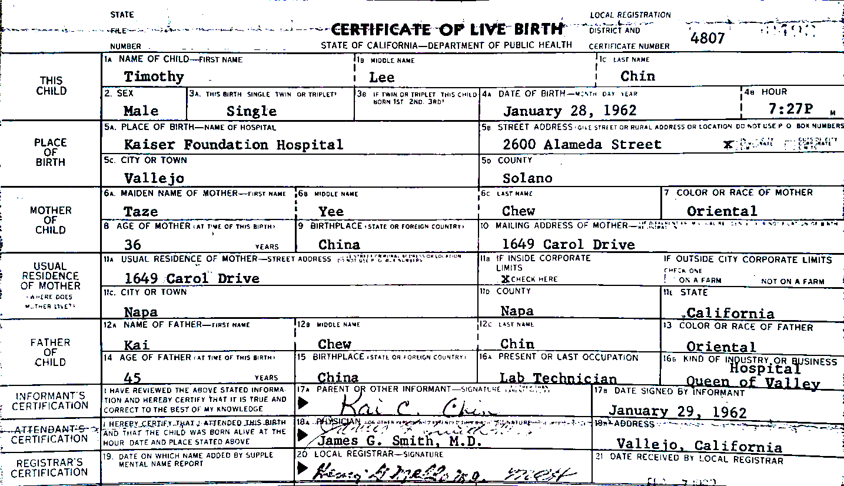
My Friend’s Father
Notes:
My friend who changed his name from his father’s paper name to their real family name.

Slide 5
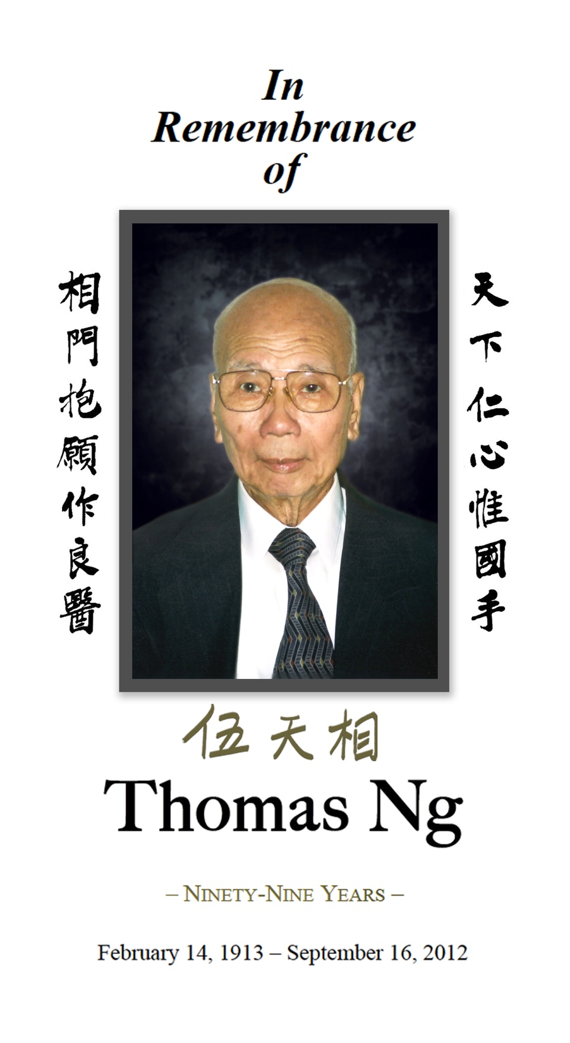
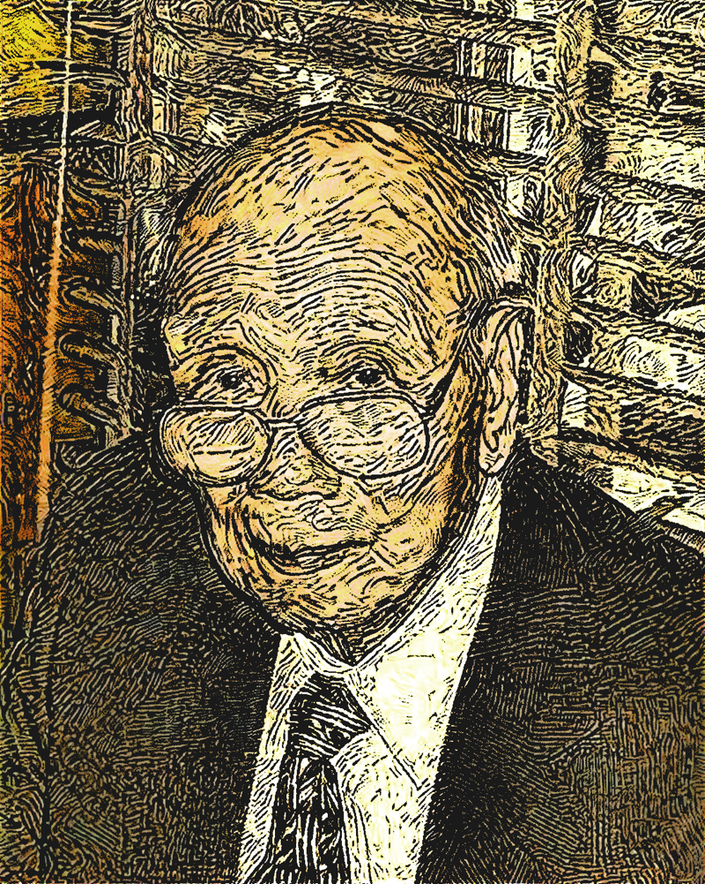
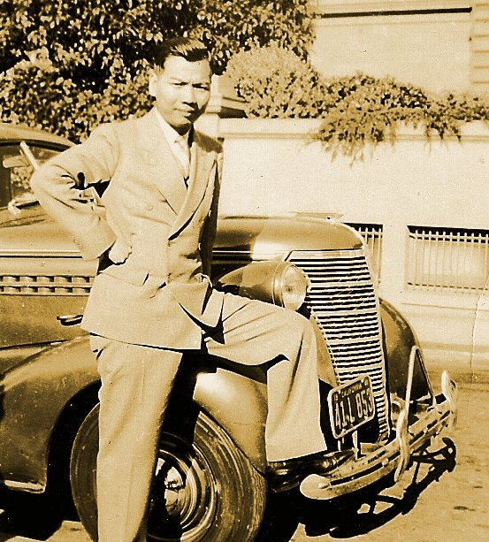
My Father
Notes:
My father’s entry into the country.

Slide 6
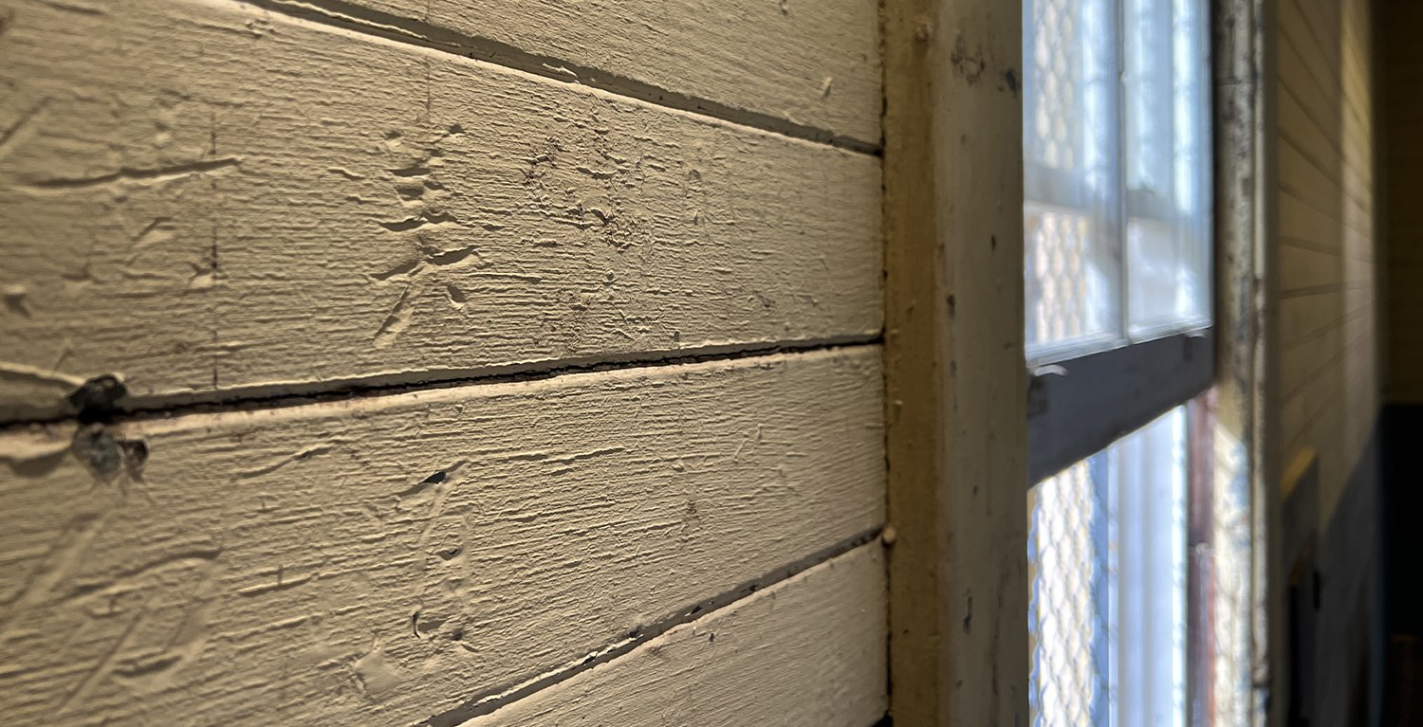
The Poems
Notes:
What finally inspired me to write the novel: the poems on the walls.

Slide 7
The Origins
ℹ️
Lesson #1
Write your bliss.
The history
My friend’s father
My father
The poems
Notes:
The best origin story is when the subject simply delights you.

Slide 8
The Surprises
The stairs
The Go board
The Black kitchen worker
Notes:
Small details that ended up playing a big role in the resulting book.

Slide 9
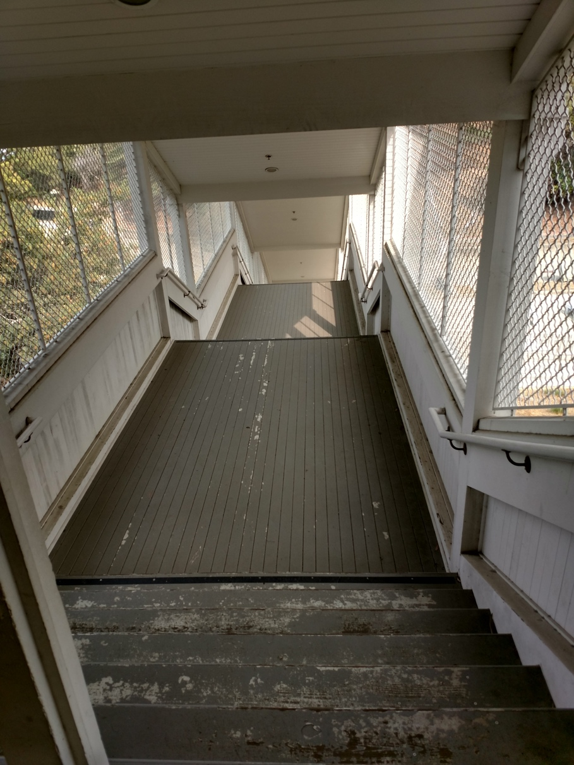
The Stairs
The dining hall
is across the way and down
a slope. Between
is the stairway
we take to get there. Roofed,
with metal grating
on either side, it can only
be entered from inside
the buildings: a caged stairway
or a stairway inside a cage.
Notes:
Surprised that the outdoor stairway from the barracks to the dining hall was itself caged, which helped me realize this place was essentially a prison.

Slide 10
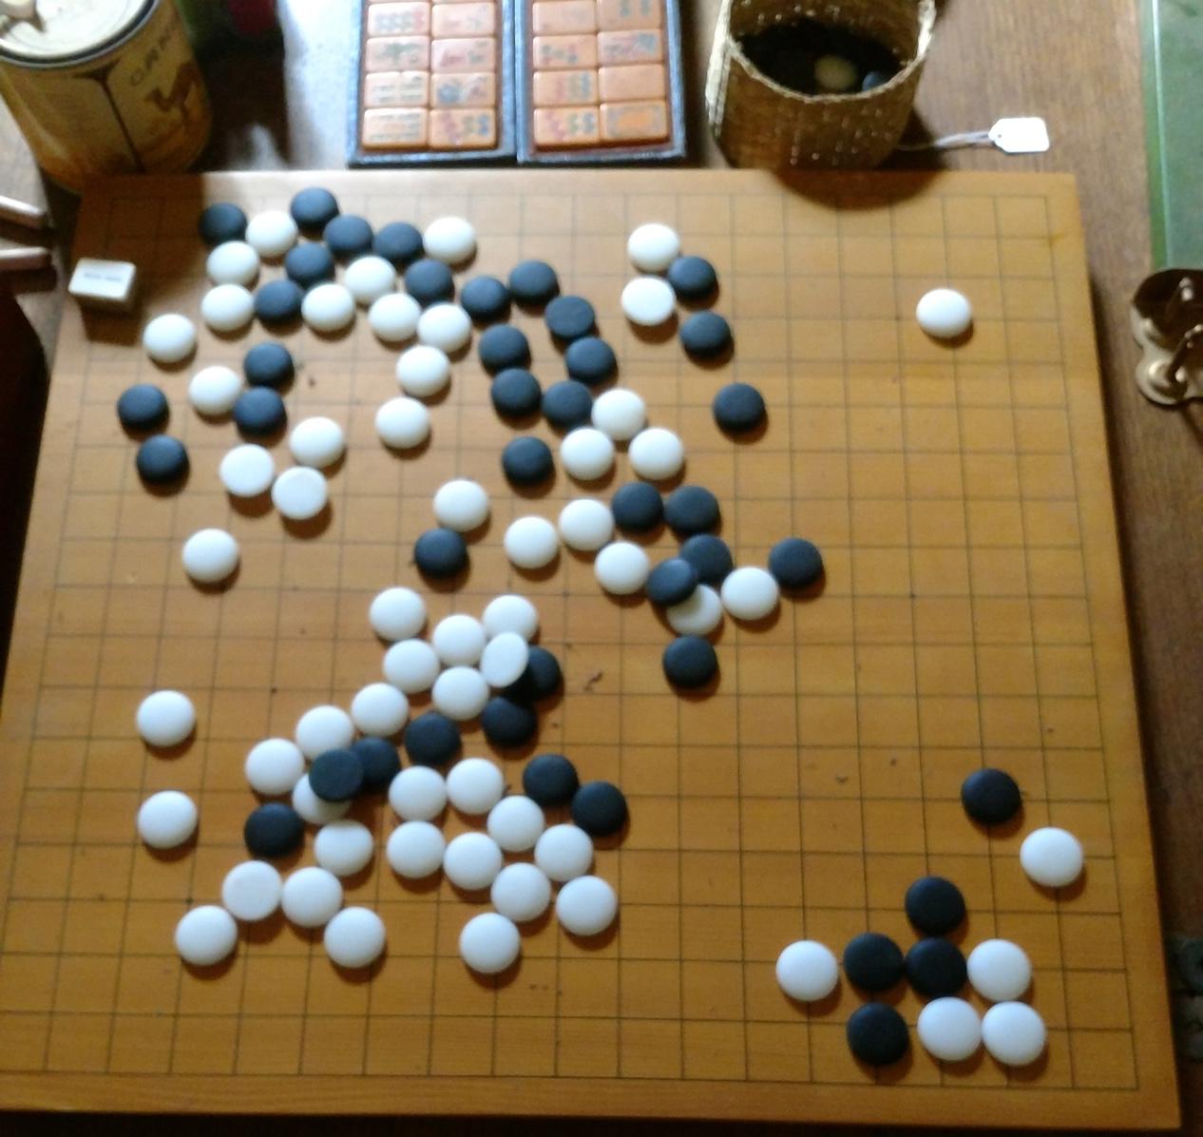
The Go Board
Notes:
The Go board in the museum’s recreation of the barracks rec room. A game I play that ended up playing a key role in the story.

Slide 11
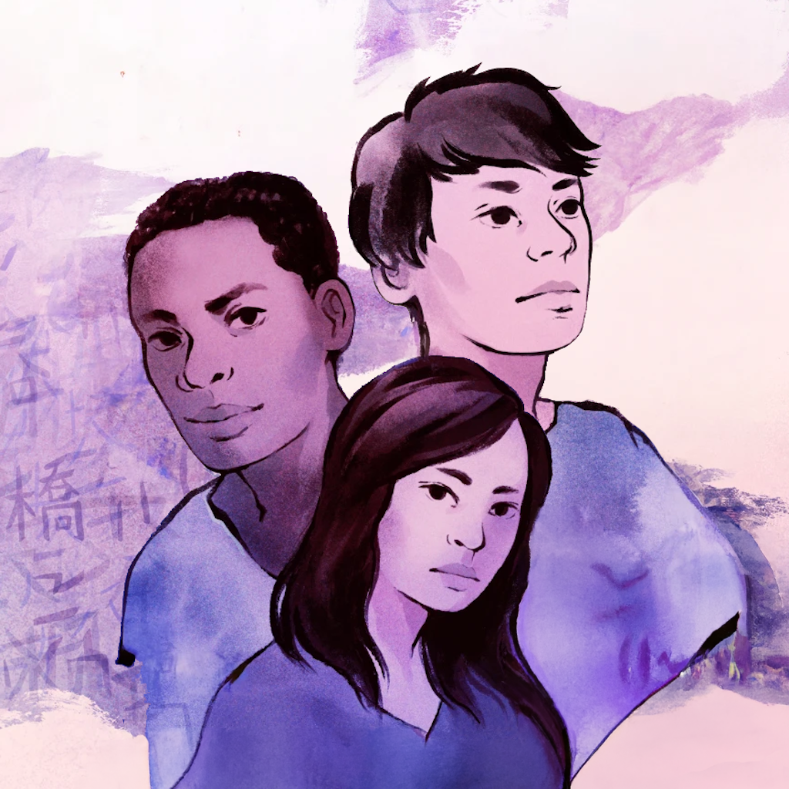
The Black Kitchen Worker
Notes:
The Black teen kitchen worker: a side idea that found its way into the heart of the novel.

Slide 12
The Surprises
ℹ️
Lesson #2
Run with it.
The stairs
The Go board
The Black kitchen worker

Slide 13
The Revisions
My critique group
My agent
My editors
Notes:
The extensive revision process the book underwent.

Slide 14
My Critique Group: The ”Pale Powers”
Father and Grandfather
call them “white ghosts.” To me,
they are the pale powers. Ghosts
have the power only to haunt,
to frighten. These white faces
sit behind the desks
we line up at. They ask
the questions. They
guard the doors.
Notes:
A member of my critique group forced me to go beyond having my protag call the whites “white ghosts”.

Slide 15
My Agent: Kow Loon
At dinner, I look
across the rows of tables, counting
all the stories packed
into this crowded hall. Knowing
that for every man
who thinks himself
the only hero of the story
of his family, there are wives
and daughters, sisters
and mothers, left
back home or waiting
like us, across the way
in the women’s dorm,
whose stories still wait
to be told.
Notes:
My agent pushed me to add more about my protag’s family background, and that led me to putting my late sister into the story.

Slide 16
Simon & Schuster Editors
My editor
Senior editor
Copyeditor
Designer
7 months
6 round trips
983 comments
Notes:
The extensive revision process with a team of Simon & Schuster editors.

Slide 17
Simon & Schuster Feedback
The feelings
Give me a break, dude!
The cultural tightrope
Notes:
Some of the revisions made through the S&S process.

Slide 18
The Feelings
I’m electrified,
on fire, the morning light
that streams
into the barracks through
barred windows. I’m lit
with hope, desire, with
gratitude to the universe,
Yukiko, Boocher.
Notes:
Editor pushed me to always say more about how my protag was feeling.

Slide 19
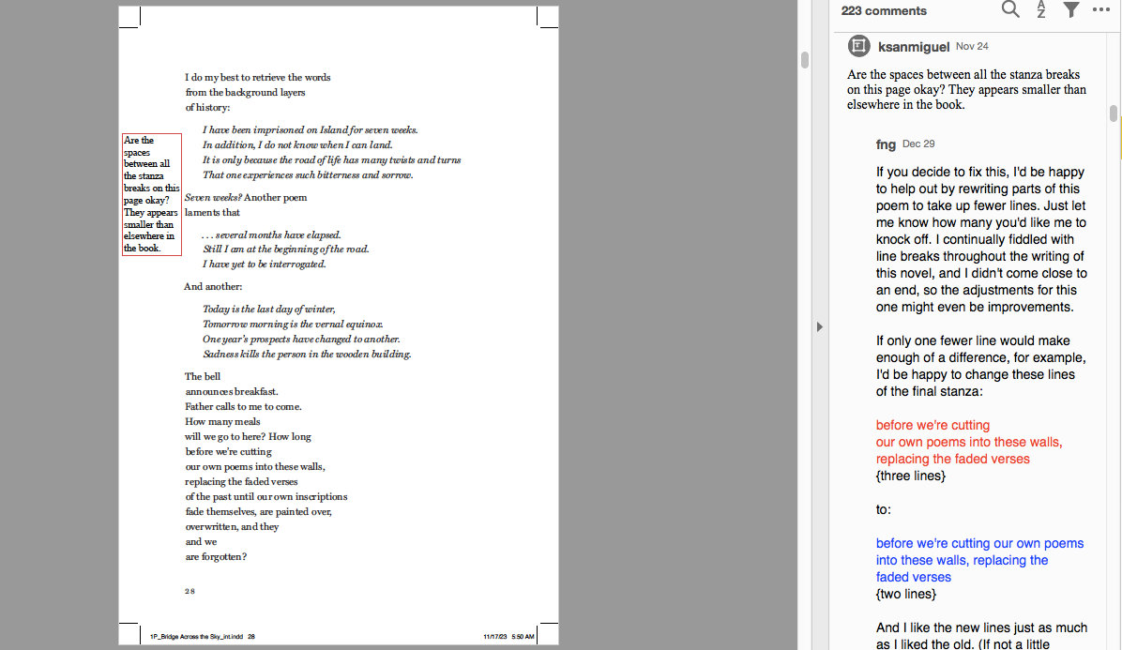
Line Breaks
Notes:
Edits I made to line breaks in order to improve pagination

Slide 20
Dudes and Newbs
I sleep upstairs, but I like
to come down here to check out
the newbies. You probably
want to unpack and settle in,
but tomorrow, I can give you
the grand tour, if
you like.
Notes:
The question of “dude” vs. “newb”

Slide 21
The Cultural Tightrope
Sensitivity reading
The half-Chinese girl
The “spook”
Notes:
How we worked through potentially offensive or triggering material

Slide 22
The Revisions
ℹ️
Lesson #3
Your “final” draft
is just the beginning.
My critique group
My agent
My editors

Slide 23
My Feedback on Your Work
Thanks!
Praise and criticism.
The content warnings.
At my first visit to a school of the arts, I asked the writing program director to solicit writing samples from the students, and I spent part of the talk critiquing some of their work. I’ve included those slides in this sample presentation to give you an idea of the kinds of comments I might make on your students’ work.
Notes:
Praise for their courage to share their work and be subject to feedback.
Explanation that I picked, for each piece, just one or two items I felt would be useful to share, so whether it’s praise or criticism doesn’t reflect what I thought of the piece as a whole.
Explanation for how I’m handling content warnings. (Not sharing the potentially disturbing lines.)

Slide 24
From “in another world”
we outgrew the children’s table last year,
but our knees are still scraped…
Notes:
Praise for concrete showing (vs. telling) of the situation with the table, and a suggestion that maybe this doesn’t even need the telling part.

Slide 25
Goddess of Shipwrecks
Up, down. Our tiny ship rocks in the ruthless waves. Iceland has dangerous waters. Then, the boom falls toward me, and I am submerged. I shiver as I look into the eyes of Ran, the pale goddess of shipwrecks, and I am not afraid to join Hel’s domain. It was meant to be.
Notes:
Advice about narrating action from within the character’s POV vs. the omniscient, authorial way as written.

Slide 26
From “Cows”
A raindrop splashes on my skin It travels down my lashes
Notes:
Praise for the nice sensory detail.

Slide 27
From “An Eight Year Old’s Grand Plan”
Henrietta had a plan. The perfectly formed plan for her career. She would pack her favorite leopard print suitcase, live in the woods, and watch the animals to prepare for her future.
Notes:
Praise for the unexpected, original idea.

Slide 28
From “Root Vegetables”
Portraying yourself as the Ugly Duckling, the Black Sheep, you fished for my empathy in a world of accustomed judgment
Notes:
Advice about mixed (or at least, unrealized) metaphors, and praise for the potentially interesting controlling metaphor of root vegetables, which was never really realized in the rest of the piece.

Slide 29
From “predecessor”
a child taking their first steps
a girl carving her tongue between each breath
Notes:
Praise for the powerful image and a note that this kind of surreal description is In vogue these days.

Slide 30
From “Rank”
One day the world will appreciate my efforts, I fantasize.
and I cling to that comfort as I lock my doors,
praying to be revered.
Notes:
Praise for the interesting way this undercuts the speaker’s primary desire.

Slide 31
Scramble!
August, 1940
Finally Time to serve the RAF, all it took was one little lie. Time to pack my bags for the base.
I was assigned to the legendary Spitfire! I can’t wait to aid in our defense.
I had my first victory today. I was getting congratulated all evening, yet somehow it feels empty.
I get It now. I was blinded by propaganda. We aren't just fighting machines, there is a person inside.
Every day a new formation appears on the horizon like a murder of crows. The call of “Scramble!” rings out and a new bunk becomes vacant.
Notes:
Suggestion to actually portray whatever the experience was that transformed the speaker at the beginning of the piece to the one at the end. What, specifically, triggered this change? Show the reader. (Also praise for “murder” of crows.”)

Slide 32
From “Try Again Tomorrow”
The Moon checks in on the children of this world. She shines into a young girl's room. The walls were painted gray by the Moon's glow (and, less poetically, the paint), the closet doors kept shut by a chair- the oddly lumpy, yet seemingly empty, bed sheets were a sweet lavender. The Moon let her light wander, waiting for the girl to greet her.
Notes:
Praise for the moonlight and bedsheet imagery, but a suggestion to remove the parenthetical.

Slide 33
From “Rx”
A dull sky, 132 steps in a six-story building.
How classic, New York.
For the past month you’ve gifted yourself excuses…
Notes:
Praise for the character-revealing 132 steps and excuses as a “gift.”

Slide 34
From “The Pumpkin Folk”
A man can’t go out without his clothes even if he has seeds for teeth.
When the daylight begins to take the Moon, the pumpkins kiss. The flames keeping the pumpkin kin together touch if only for a moment.
Notes:
Praise for the fairy tale logic of “even if he has teeth”, the phrasing “take” the Moon, and the idea of the pumpkins’ flames touching when they kiss.

