Slide 1
Bridge Across The Sky
The Chinese immigration experience through Angel Island in the early 1900’s.
This is an example of the presentation I might make to a general student audience. (vs. writers, for which I have a different talk.) Each slide includes a note that explains what I’d say about it.
Note that there’s a mention of suicide (#16) that I can either warn the audience about ahead of time or omit from the slideshow.
You can learn more about my novel at www.AngelIslandNovel.com

Slide 2
Why This Story?
Because we (almost) all came from somewhere.
Because…today. (Every today.)
Notes:
Why the student audience care about this story?

Slide 3
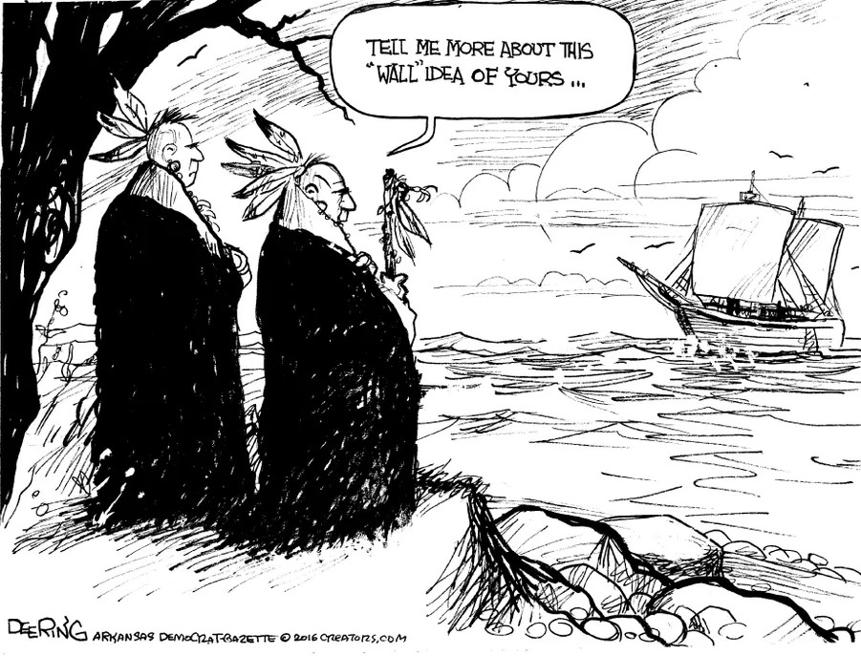
Notes:
Unless you’re a Native American, you came from somewhere else.

Slide 4
Notes:
Anti-immigrant hate a current -- and recurring -- problem in American history

Slide 5
The Chinese in America
The railroad
The Chinese Exclusion Act
The earthquake and the fire
The paper stories
The detention
Notes:
The history of the Chinese in America leading up to the building of the Immigration Station

Slide 6
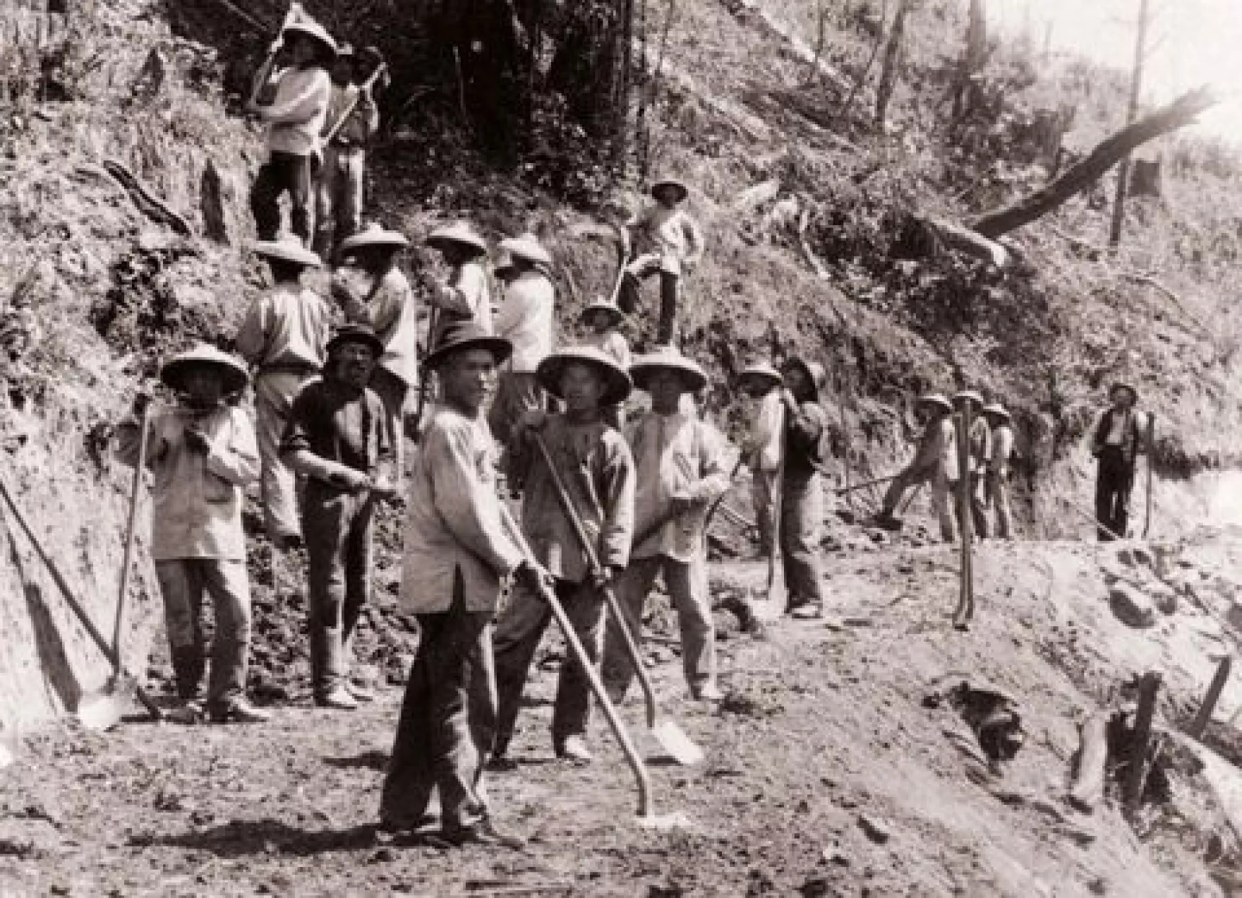
Notes:
Initial immigration to work on the Transcontinental Railroad

Slide 7
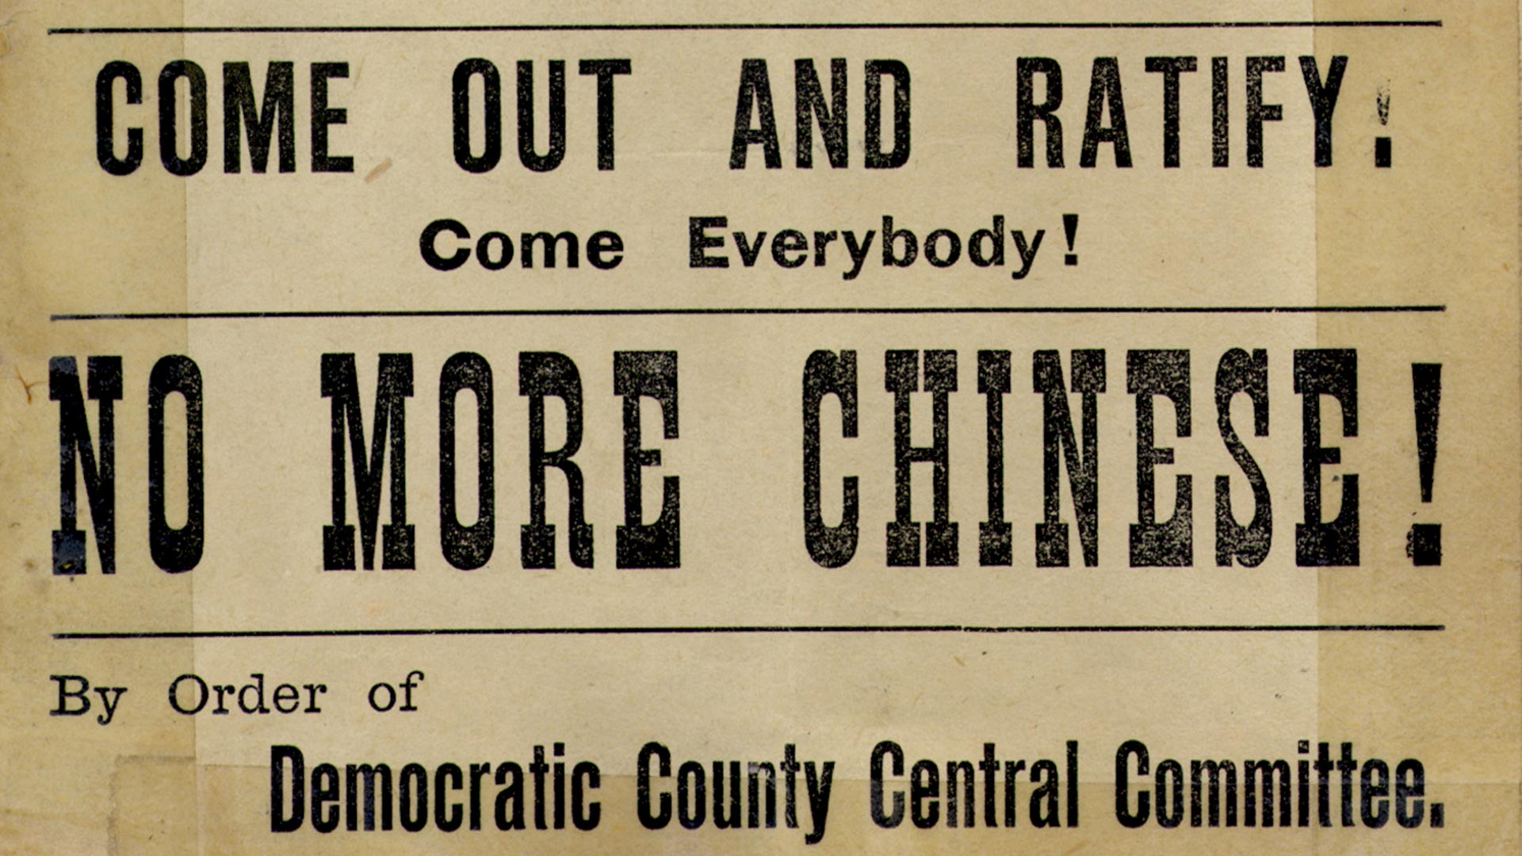
Notes:
Anti-immigrant fervor (“They’re taking our jobs”, etc.) leading to the Chinese Exclusion Act.

Slide 8
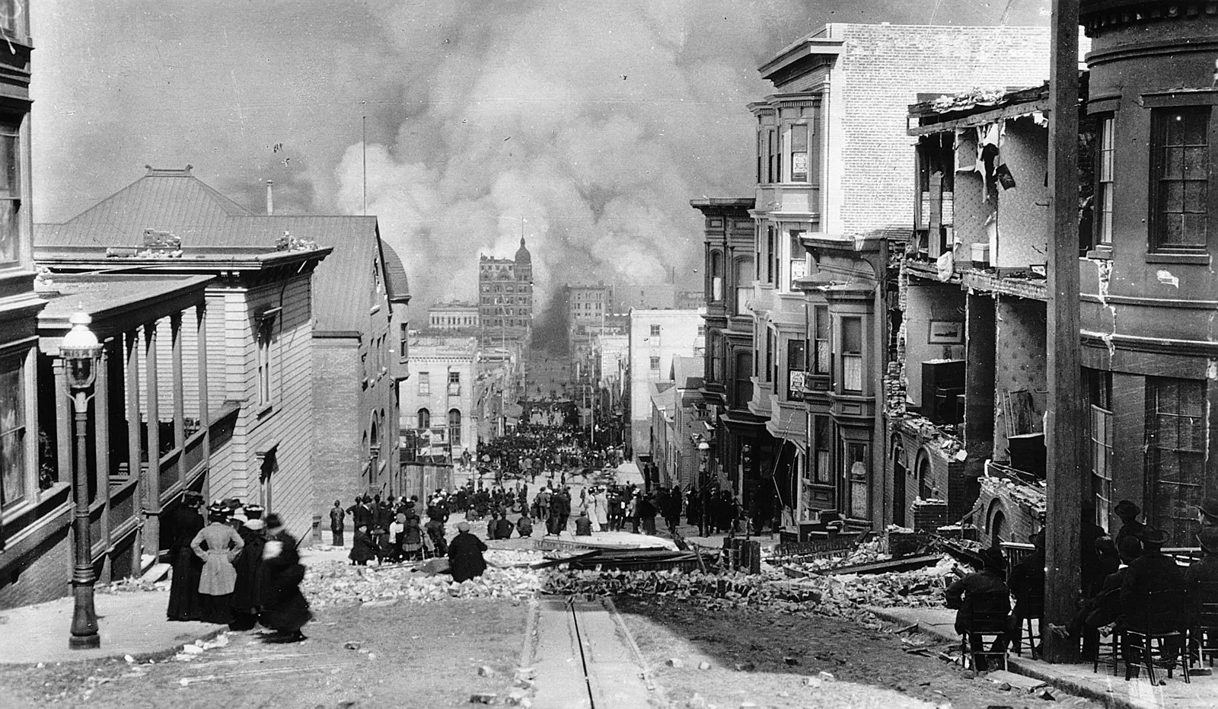
Notes:
The San Francisco earthquake and fire leading to an opening for more Chinese immigrants to enter the country.

Slide 9
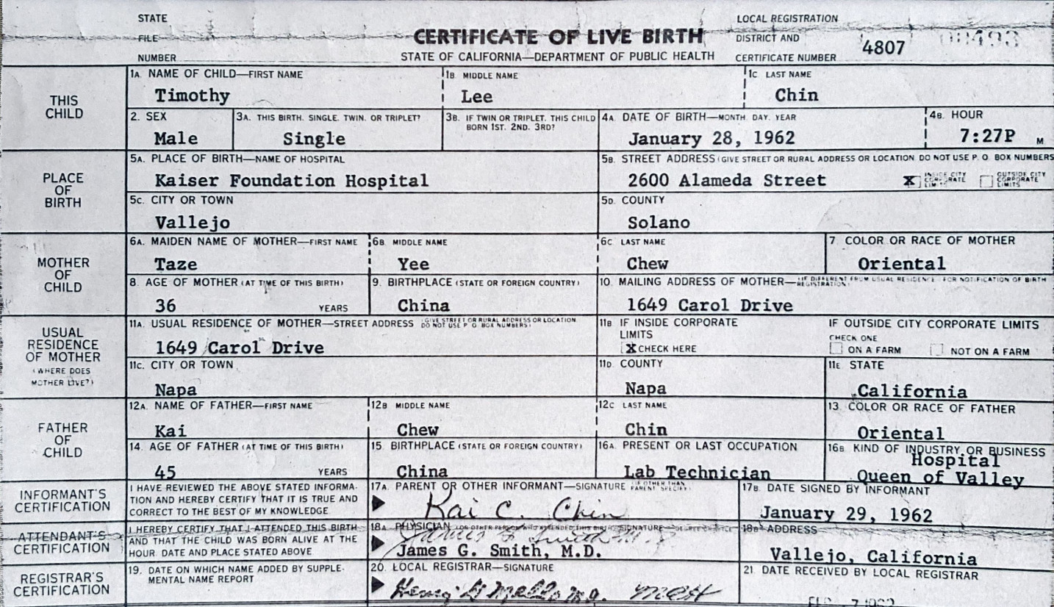
Notes:
The ”paper stories”

Slide 10
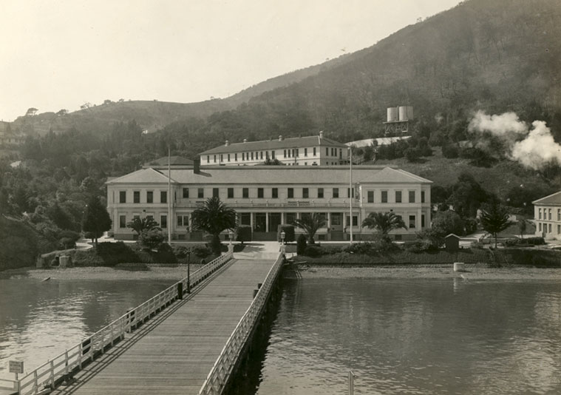
Notes:
The Immigration Station built to house detainees while their stories were checked out.

Slide 11
The Detention Experience
Essentially a prison
Mistreatment and poor conditions
Traumatizing medical exams
Riots for better conditions
Suicides
The poems
Notes:
The history of the Chinese in America leading up to the building of the Immigration Station

Slide 12
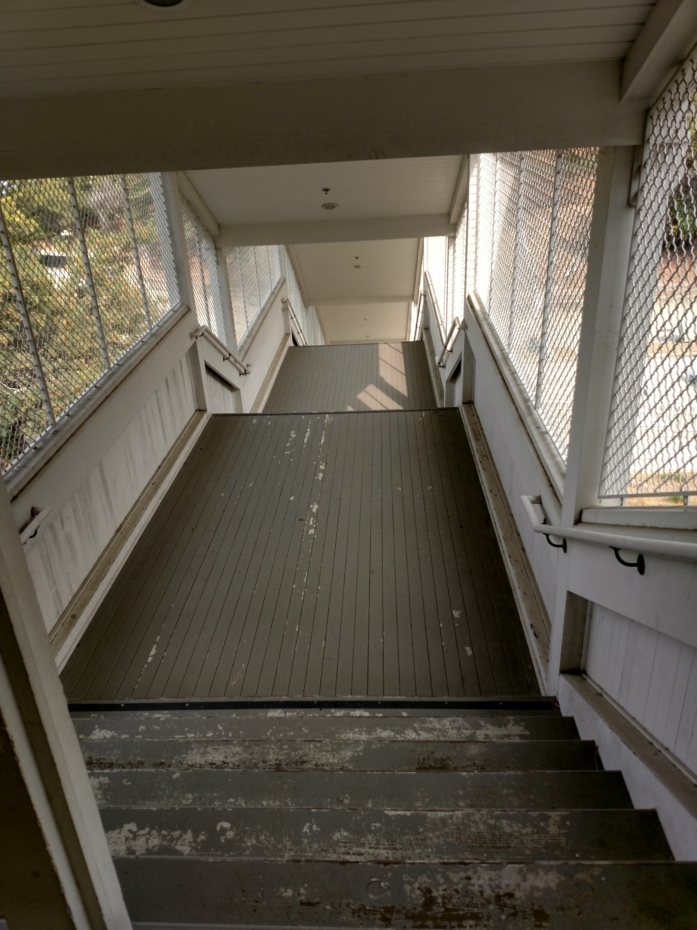
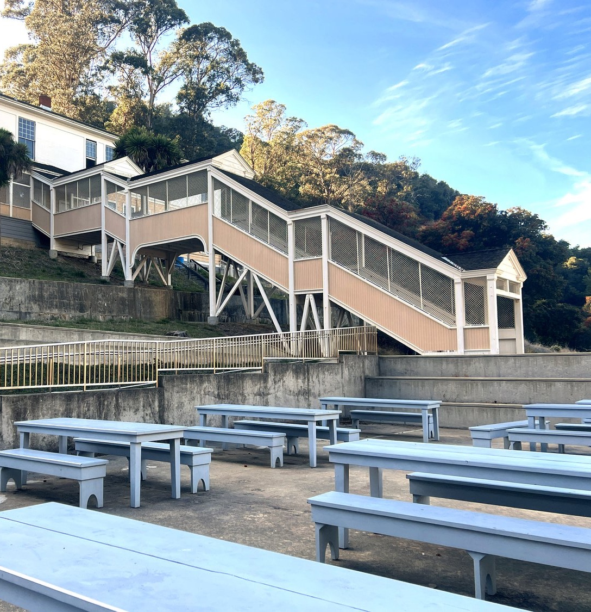
Notes:
The staircase between the barracks and the dining hall in the admin building, as it stands today. My first sign that this was a prison.
Reading from the book: “Caged” (pg. 35)

Slide 13
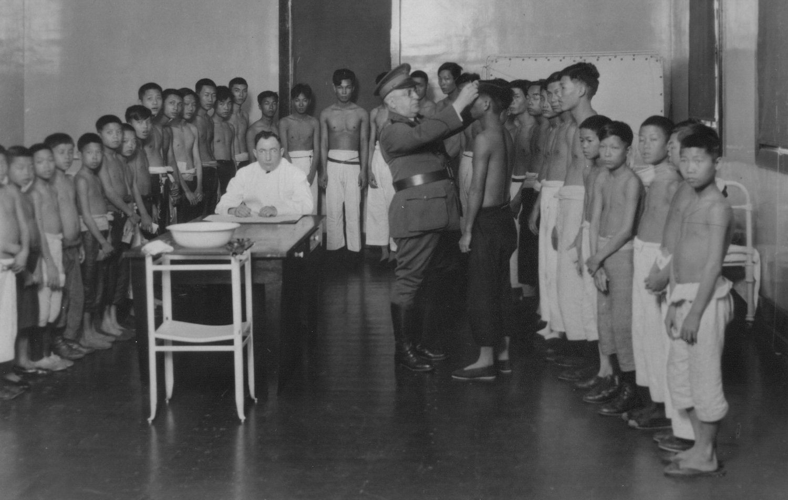
Notes:
Medical exams that were traumatizing because the Chinese weren’t used to Western medical practices.
Reading from the book: ”My Heart” (pg. 45)

Slide 14
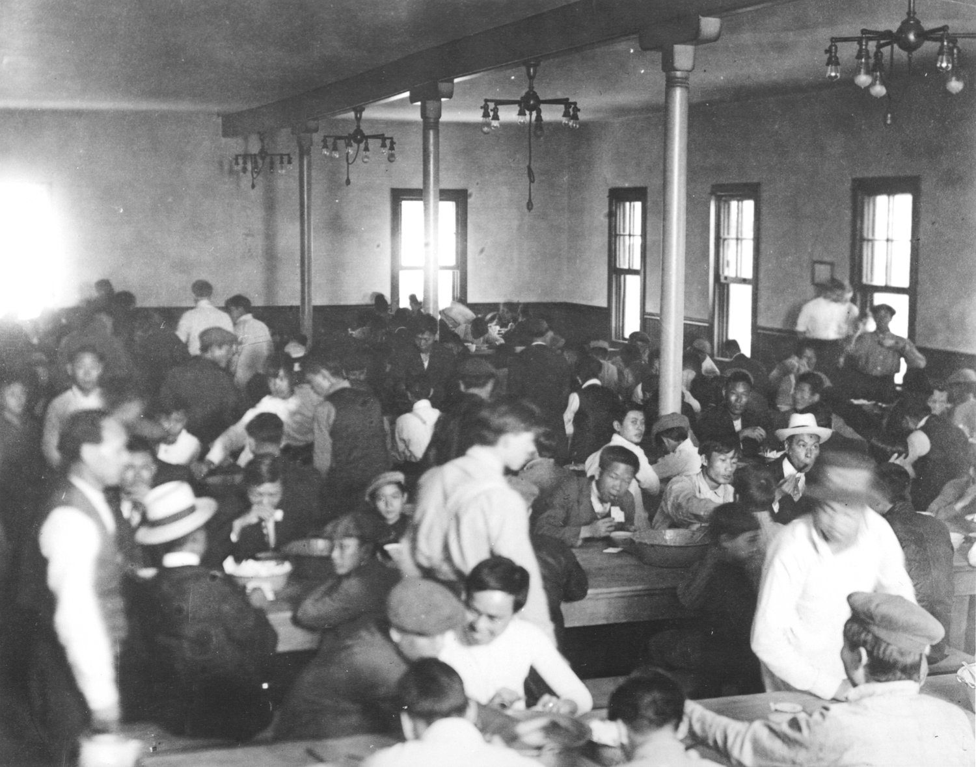
Notes:
In the history of the station, there were two riots for better conditions.
Reading from the book: “a roar” (pg. 141)

Slide 15
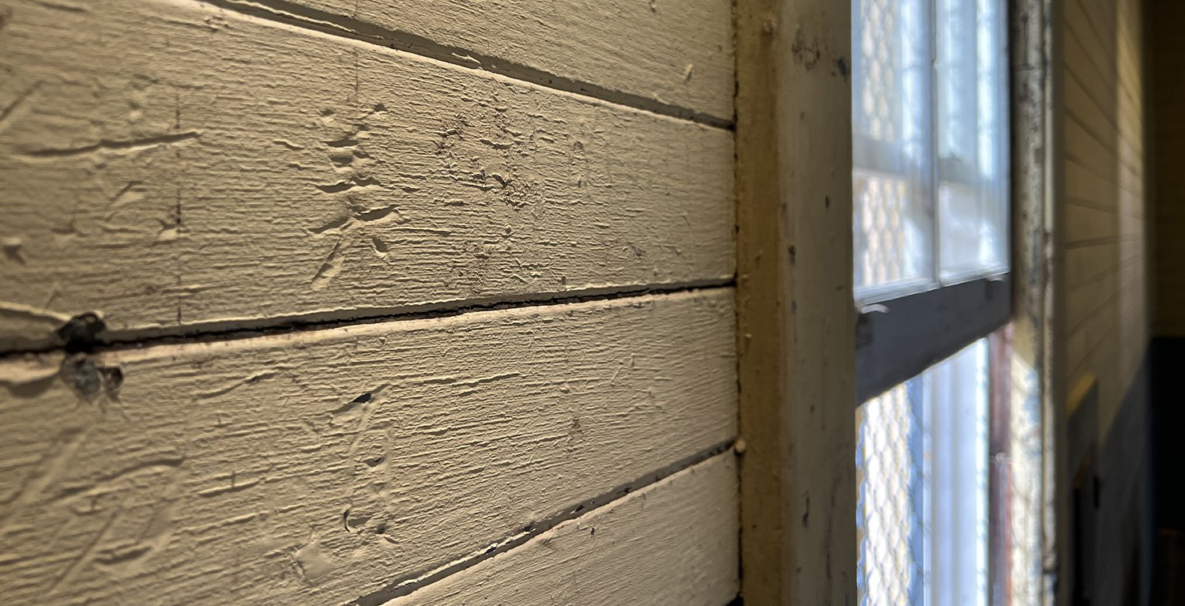
Notes:
In response to their difficult circumstances, detainees carved poems into the walls of their barracks.
Reading from the book: “poems” and “forgotten” (pg. 25)

Slide 16
走投無路別家鄉，
乘風破浪渡重洋，
一言之差河橋斷，
困囚木屋兩年長.
英雄難過美人關，
進退兩難夜靜嘆：
謝絕浮生僅一途，
冤魂飄蕩莫奈何。
My life at an impasse, I left house and home;
I braved the winds and broke through waves to cross the seas.
Yet with one wrong word, my bridge across the sky was broken;
Now I’ve been imprisoned for two years in a wooden building.
It’s hard for heroes to cross the barrier to America;
Both going forward and back are hard, and in the quiet night I sigh.
I leave behind this floating life—there's only one road for me now;
My wronged soul is doomed to wander—what else can I do?
-- translation by Charles Egan, from Island: Poetry and History
-- of Chinese Immigrants on Angel Island, 1910-1940,
-- second edition, University of Washington Press,
-- edited by Mark Lai, Genny Lim, and Judy Yung
Notes:
The wall poem I took the title of my book from…was a suicide poem.

Slide 17
More Wall Poems
Mistreatment
Delays
Trauma
Revenge
Hopes
Despair
Love
Notes:
I’ll share as many of the following poems as time allows. This is the mechanism I’ll use to make sure the presentation fits the allotted time.

Slide 18
狼醫要驗勾蟲症； 不能登陸運不靈。
青年何苦輕生命； 冤沉二字向誰鳴？
I cannot bear to describe the harsh treatment by the doctors.
Being stabbed for blood samples and examined for hookworms
was even more pitiful.
After taking the medicine, I also drank liquid
Like a dumb person eating the huanglian.
-- translation by Genny Lim, from Island: Poetry and History
-- of Chinese Immigrants on Angel Island, 1910-1940,
-- second edition, University of Washington Press,
-- edited by Mark Lai, Genny Lim, and Judy Yung
Notes:
Traumatizing medical practices.

Slide 19
埃屋三椽聊保身， 崙麓積愫不堪陳。 待得飛騰順遂日， 剷除稅關不論仁。
The low building with three beams merely shelters the body.
It is unbearable to relate the stories accumulated
on the Island slopes.
Wait till the day I become successful and fulfill my wish!
I will show no mercy when I level the immigration station!
-- translation by Genny Lim, from Island: Poetry and History
-- of Chinese Immigrants on Angel Island, 1910-1940,
-- second edition, University of Washington Press,
-- edited by Mark Lai, Genny Lim, and Judy Yung
Notes:
Revenge!

Slide 20
乞巧少四日,
搭輪來美洲。
光陰似箭射，
又已過涼秋。
屈指經數月，
尚在此路頭。
至今未曾審,
懸望心悠悠。
Four days before the Qiqiao Festival,
I boarded the steamship for America.
Time flew like a shooting arrow.
Already, a cool autumn has passed.
Counting on my fingers, several months have elapsed.
Still I am at the beginning of the road.
I have yet to be interrogated.
My heart is nervous with anticipation.
-- translation by Genny Lim, from Island: Poetry and History
-- of Chinese Immigrants on Angel Island, 1910-1940,
-- second edition, University of Washington Press,
-- edited by Mark Lai, Genny Lim, and Judy Yung
Notes:
Interminable detentions.

Slide 21
間有偶觸胡怒，
拳脚交加。
忽起狼心，
鎗頭向指。
…
At times, the barbarians would become angry with us;
They kick and punch us severely.
By chance, in their sudden cruel moment,
They would point their guns at us.
…
-- translation by Marlon K. Hom, from Island: Poetry and History
-- of Chinese Immigrants on Angel Island, 1910-1940,
-- second edition, University of Washington Press,
-- edited by Mark Lai, Genny Lim, and Judy Yung
Notes:
Mistreatment.

Slide 22
夜靜微聞風嘯聲， 形影傷情見景詠。 雲霧潺潺也暗天， 蟲聲唧唧月微明。 悲苦相連天相遣， 愁人獨坐倚窗邊。
In the quiet of night, I heard, faintly, the whistling of wind.
The forms and shadows saddened me;
upon seeing the landscape, I composed a poem.
The floating clouds, the fog, darken the sky.
The moon shines faintly as the insects chirp.
Grief and bitterness entwined are heaven sent.
The sad person sits alone, leaning by a window.
-- translation by Genny Lim, from Island: Poetry and History
-- of Chinese Immigrants on Angel Island, 1910-1940,
-- second edition, University of Washington Press,
-- edited by Mark Lai, Genny Lim, and Judy Yung
Notes:
Despair.

Slide 23
舉筆寫詩我卿知; 昨夜三更嘆別離。 情濃囑語今猶在; 未知何日得旋歸。
I raise my brush to write a poem to tell my dear wife,
Last night at the third watch I sighed at being apart.
The message you gave with tender thoughts is still with me;
I do not know what day I can return home.
-- translation by Genny Lim, from Island: Poetry and History
-- of Chinese Immigrants on Angel Island, 1910-1940,
-- second edition, University of Washington Press,
-- edited by Mark Lai, Genny Lim, and Judy Yung
Notes:
Loneliness and passion.

Slide 24
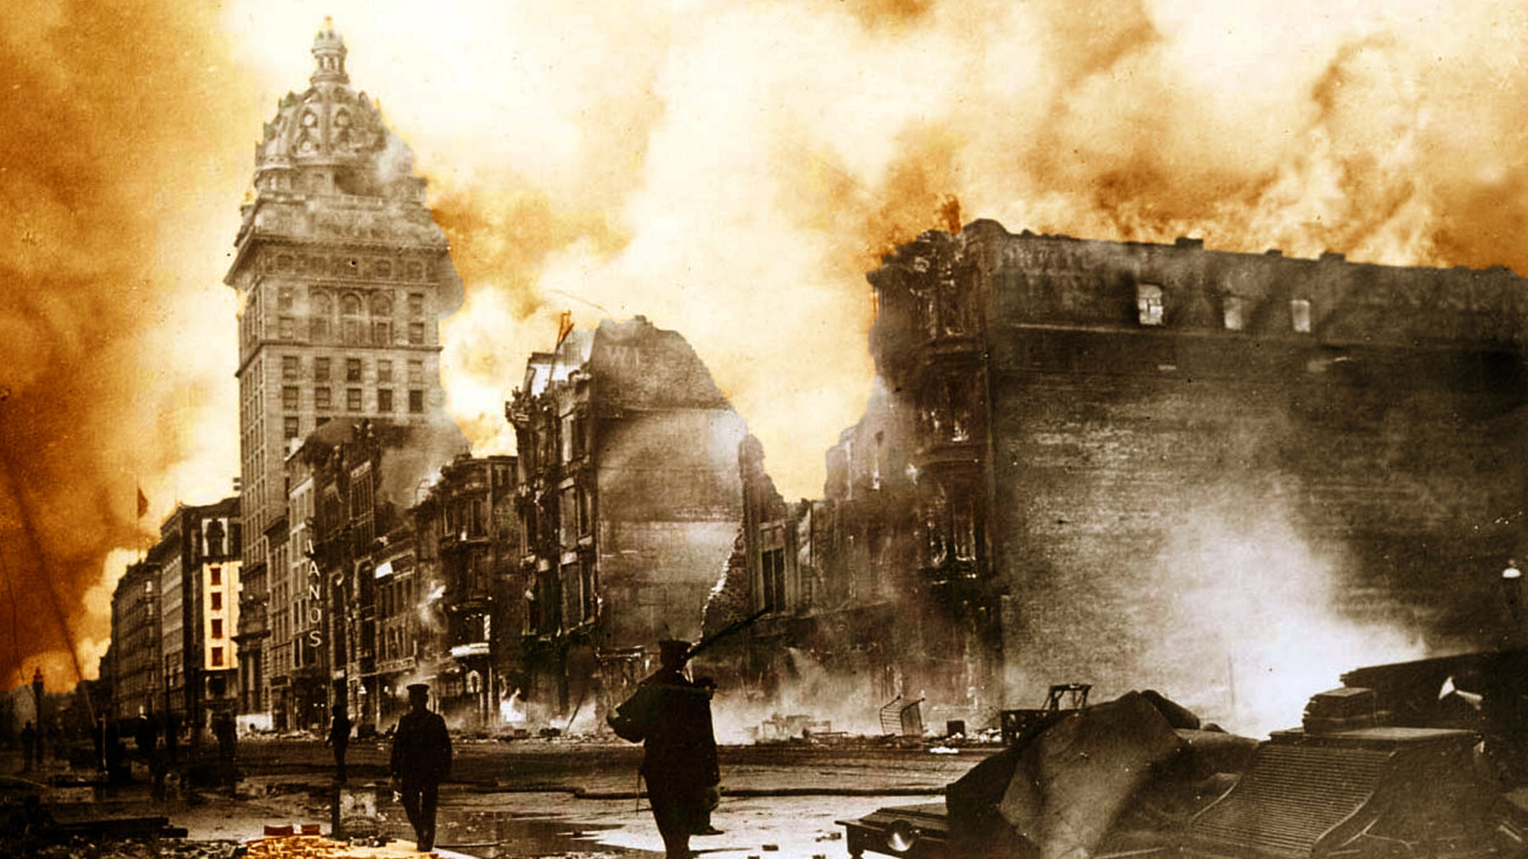
Notes:
I’ll conclude by reading a final poem from the book: “From Rubble” (pg. 167)

